Slide 1



Slide 2
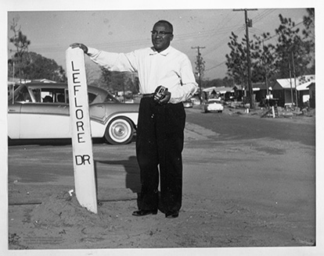
Meet: John LeFlore
John LeFlore was a civil rights leader who grew up Down the Bay and worked as a postman in the community. He worked for the National Association for the Advancement of Colored People (NAACP) to fight for African American equality in employment and voting rights. Today, LeFlore High School is named after him.
Janet Leflore, The Doy Leale McCall Rare Book and Manuscript Library, University of South Alabama

Slide 3

Marjorie Kenny Jones
“In that area, you had your shoe shops, your beauticians; their little stores. You had Leon Dry Good, which was the area where we would go to get the clothes. And right on the corner was the drug store, Parker’s Drugstore. All down that area, you would find little eateries. And it was the main district, Texas Street.”

Slide 4
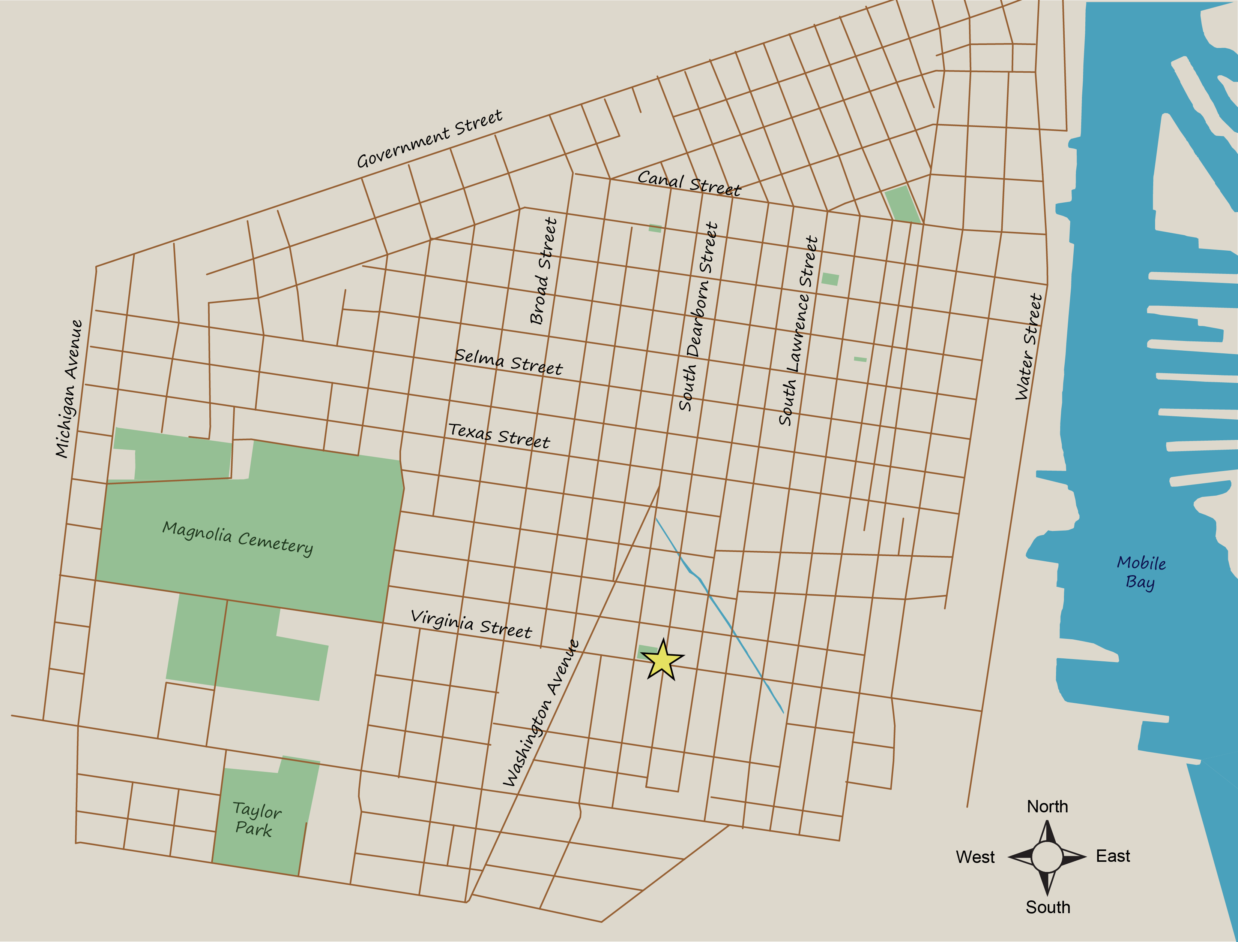
Down the Bay Journey

Slide 5
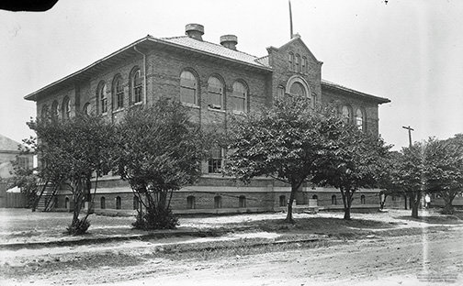
Council School
Virginia and Dearborn Streets
“Council was a—it was a school. It was like Williamson. Back when I was going to school, teachers had an interest in their students. And they taught you. But the first thing that we did in school was we had assembly. And in assembly, you learned scriptures, you learned prayer, you learned hymns—which is not allowed in schools now, but back then that was what you did. And teachers taught basics. You had your exercise—well, they didn’t have physical education classes like they do now, but you did exercise. You went outside, and you studied nature and all this kind of stuff around the school area.”
-Mattie Gulley, 2022
Erik Overbey Collection, The Doy Leale McCall Rare Book and Manuscript Library, University of South Alabama

Slide 6
Walk 3 Blocks to the East

Slide 7
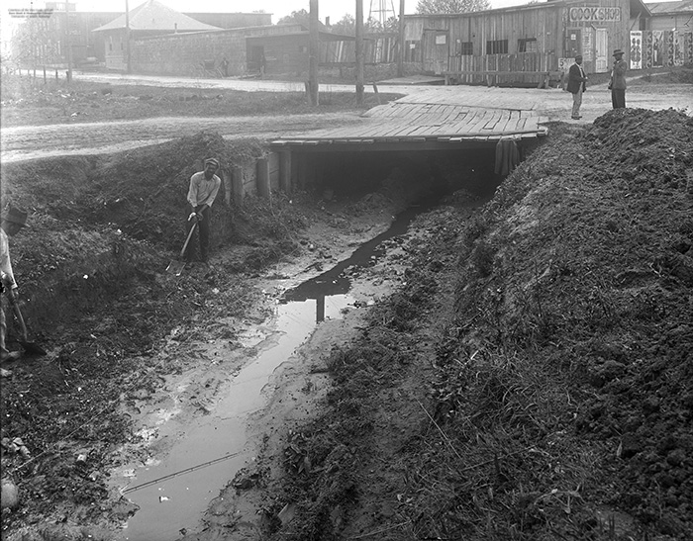
The Ditch
Virginia and S. Lawrence Street
“There was a ditch we called the Big Ditch. Used to run right on through them apartments, but they covered all that up. And right over on the corner here, Mr. Kennedy had a garage right there. Can’t think of Mr. Kennedy’s first name. Then on the next street over on the corner, the Ditch ran by—Pollman had a barber shop sitting on the corner, and the Ditch ran by the shop.”
“It—well it emptied into another little tributary, and it flowed the water to the river. But that Ditch, it was wide as a street.
“And then you had this barbeque place, it was well known: Fletcher’s. Now they say that Ditch—and every now and then, when it rain really, really hard, it’ll flood real bad where that Ditch was.”
-David Smoots, 2022
Erik Overbey Collection, The Doy Leale McCall Rare Book and Manuscript Library, University of South Alabama

Slide 8
Walk 4 Blocks North and 2.5 Blocks East

Slide 9
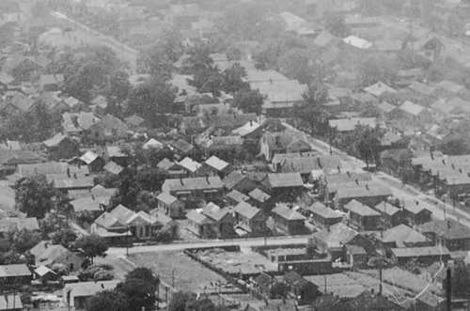
Our Alley
Texas Street and Our Alley
“How could I ever forget Ours Alley. Ours Alley went from Canal Street to Texas Street, yeah I know it. I know where it is. I know what it was. I went down it a many days. Yes I did. Now I told you I lived on Hamilton Street between Canal and Palmetto. Ours Alley started at Canal Street and went all the way to Texas. It stopped at Texas Street. Yes. Never paved, dirt all the way through. When it rained, some people did it but it was terrible going down Ours Alley [laughter] when it rained. Nothing but dirt, many people got stuck, couldn’t get out. Had to get out and walk through the mud. Leave the cars there or the truck whichever one they were driving. I didn’t think you’d mention Ours Alley. Somebody told you about that or you know about it?”
“Well I went down it for a number of different reasons. I knew some people who lived in there, for one. It was a shortcut to some of the places where I would go Down the Bay. Then also it was an area that had fruit trees growing. In there, you know like plums? And the scuppernong grapes. Those things were prevalent during that time.”
“Yeah, you know it just wasn’t no, you know like people have specific things growing in their yards and whatever. But you can walk down Ours Alley man and a peach tree and like I say those scuppernongs and things was all just growing wild.”
-Roy Butler, 2023
Our Alley in 1922, courtesy of the National Archives.

Slide 10
Walk 2 Blocks North and 5.5 Blocks West

Slide 11
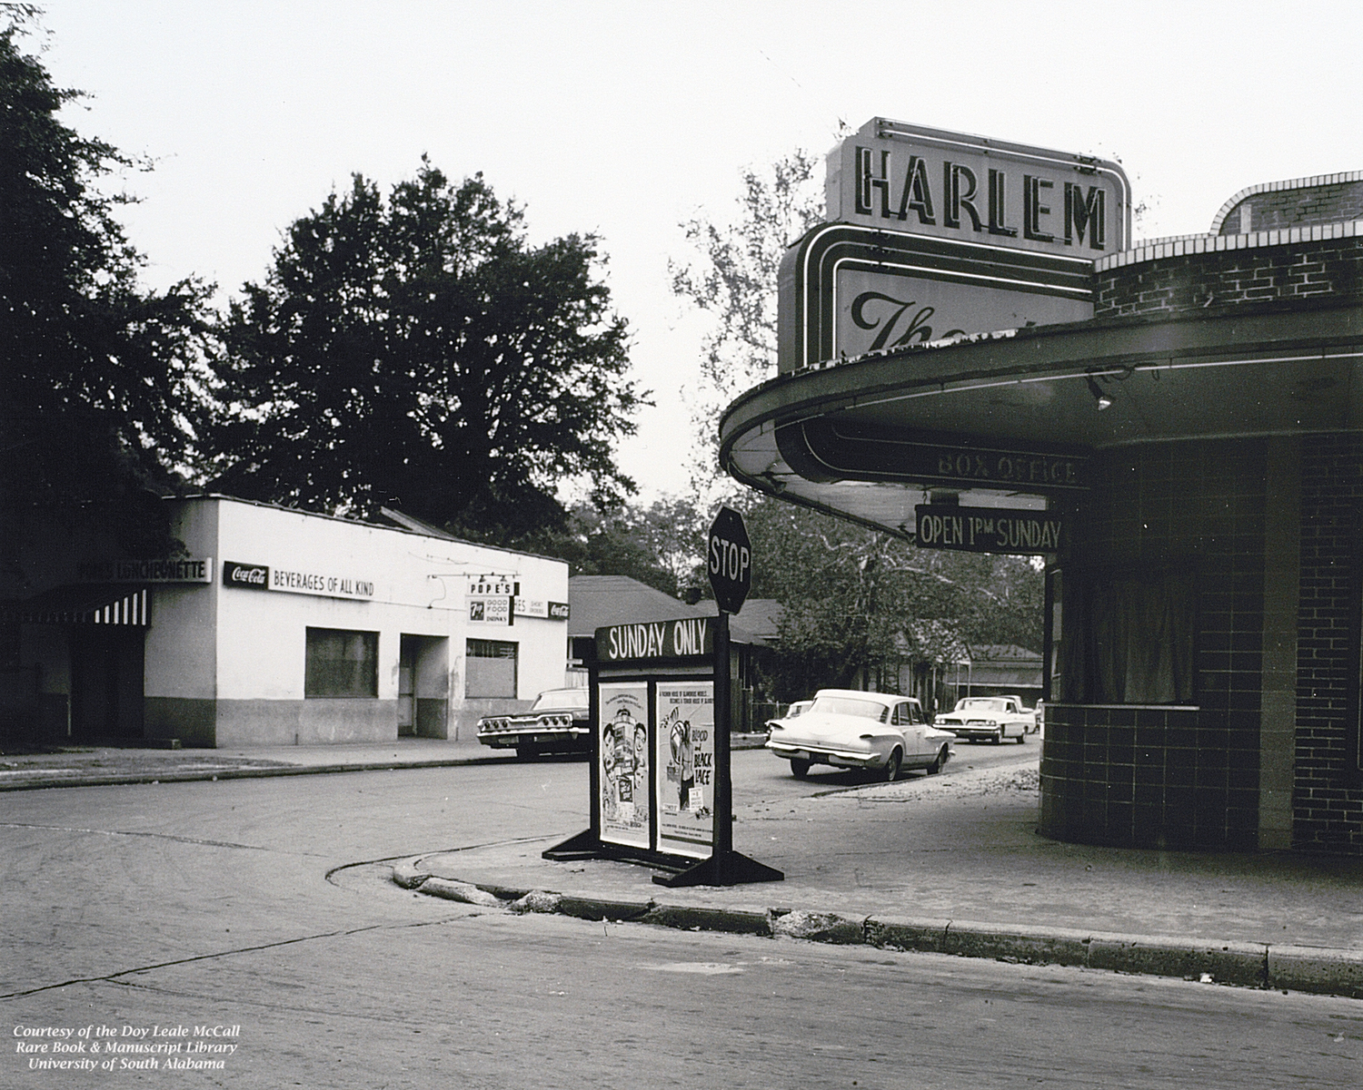
Harlem Theater
S. Dearborn and Selma Street
“Talk about Pope’s and the theater, the Harlem Theater, that’s where I went every Sunday. Pope’s Luncheonette was the other place but it was a bar so kids couldn’t go over there. But during the day you could go and get a sandwich and get a take-out, that was okay. But the movie theaters Down the Bay was called the Harlem Theater and you got a dime every Sunday and that’s where all the Down the Bay kids went in the afternoon, was to the Harlem Theater. I forgot about the movie theater. We did have that and you say, “What did we do?” we did go to the Harlem Theater, I remember that too. I’m literally visually now going through these different neighborhoods to see what I can remember. I remember Fletcher’s, I remember the Harlem Theater, I remember my school, church, the neighborhoods, I see it all now. I was a gathering place, the movies.”
-Alexis Herman, 2023
Mobile Housing Board Collection, The Doy Leale McCall Rare Book and Manuscript Library, University of South Alabama

Slide 12
What people, places, or traditions make your community special?

Slide 13


Slide 14
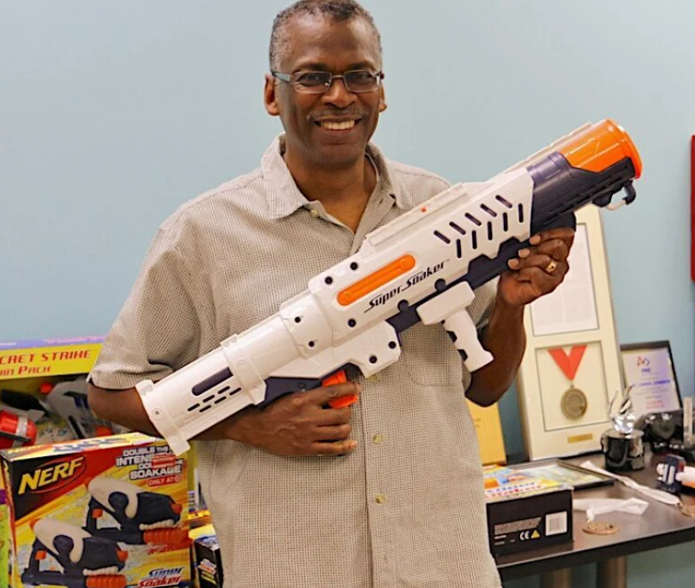
Meet: Lonnie Johnson
Lonnie Johnson grew up Down the Bay and is an inventor, engineer, and scientist. He worked for the US Air Force and for NASA, where he worked on several space missions, including the Mars Observer, the Cassini-Huygens mission to Saturn, and the Galileo mission to Jupiter. He is best known for inventing the super-soaker.
Courtesy of Johnson Research and Development Inc.

Slide 15
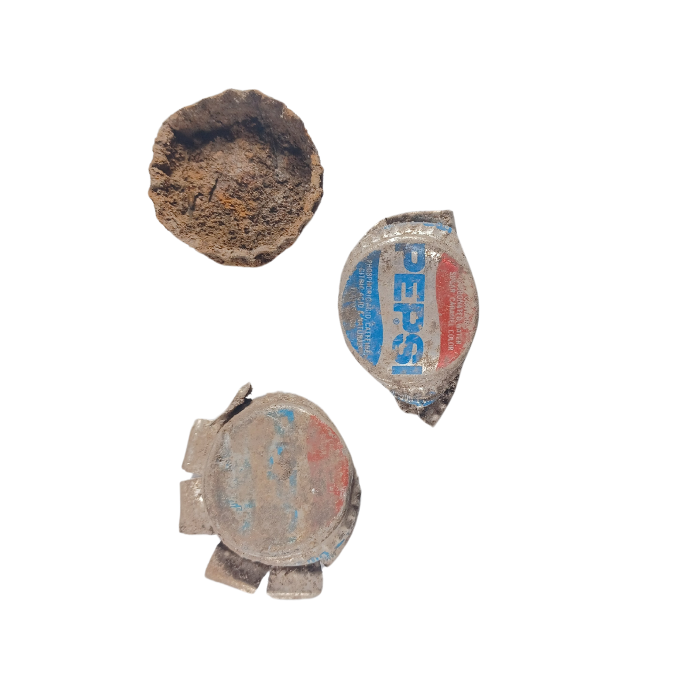
Clauzell McCovey
“Until they called us in the house, we’ll stay out there and play top ball. We would get like a broomstick or a mop handle and we’d get these tops… [W]e would pitch these bottle caps to us. And tried to hit them with a broomstick. We’d be out there sometimes late at night, and we’d hit them tops. My brother, Hank Aaron, Amos Otis; all them guys learned how to do that with those bottle caps.”

Slide 16
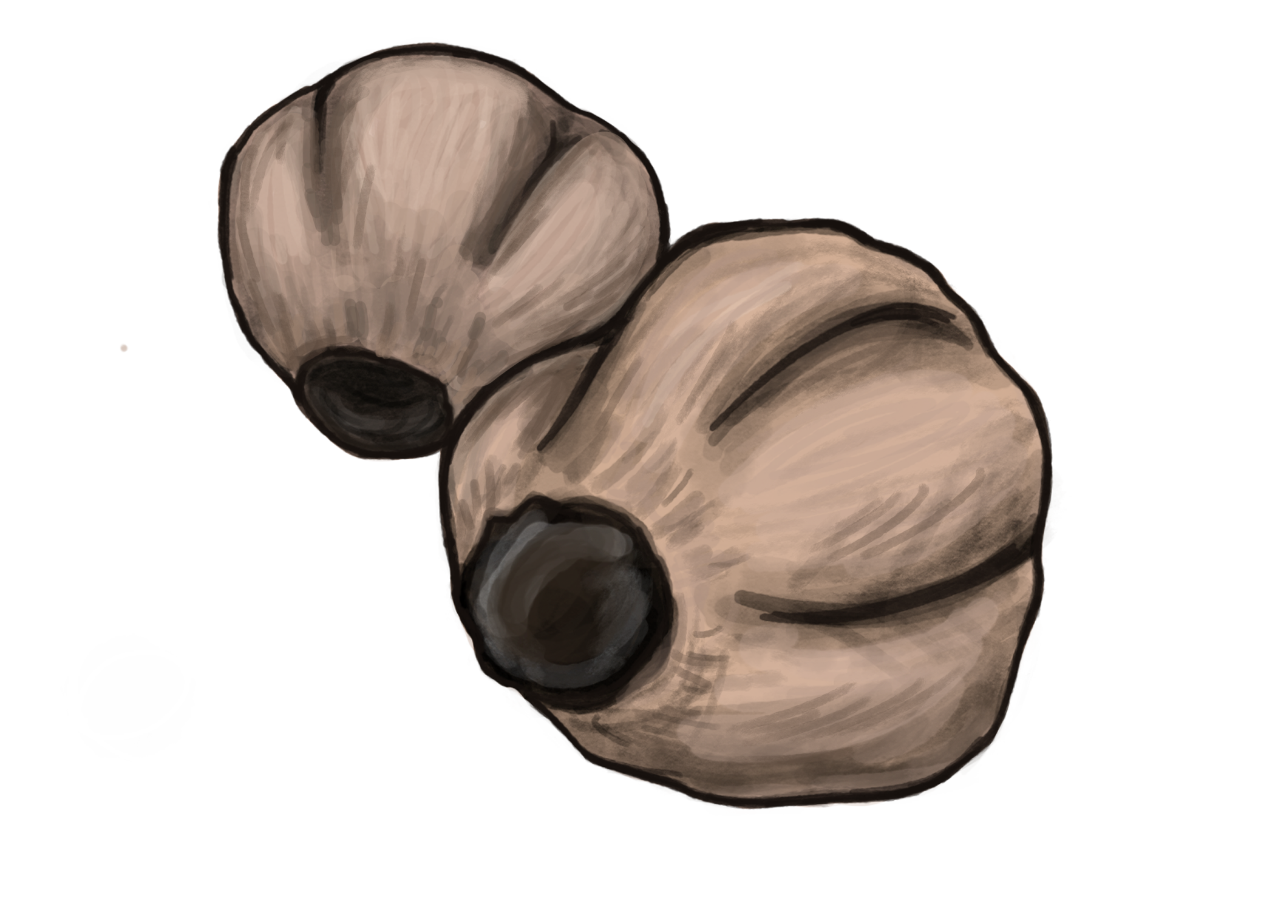
Leonard Stiell
“Used to have chinaberry trees… That was today’s version of paintball….They kind of grew—the cane grew up in the neighborhood, and we’d go cut down a cane and make your popgun.”

Slide 17
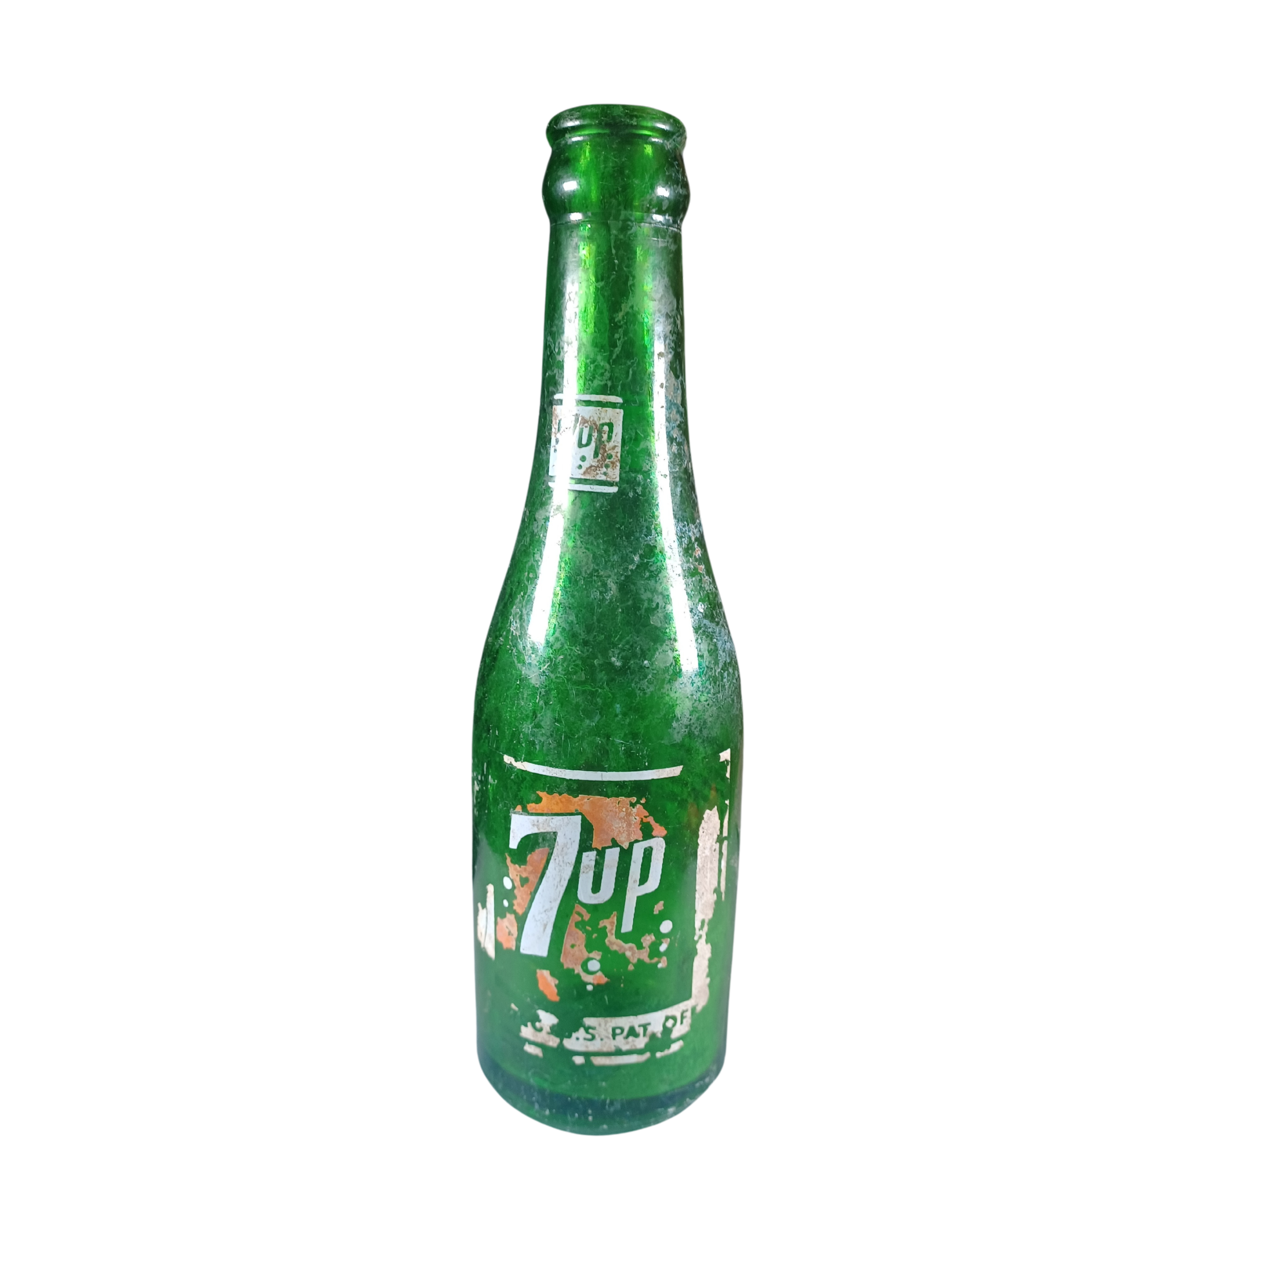
Denise McAdory
“I remember making a doll out of a 7-Up bottle. You know, you would go and somebody had some bamboo, and you would take the—we called it “hair”—off the bamboo and stick it inside the bottle, and that was our doll.”

Slide 18
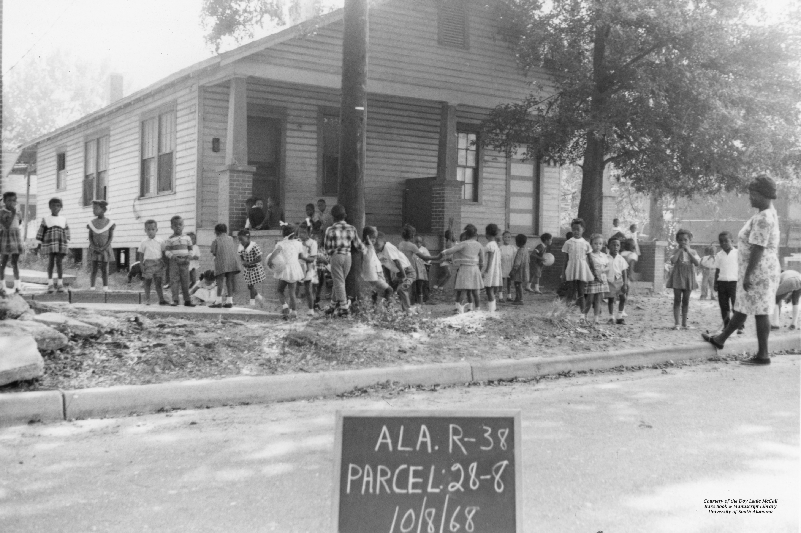
Anna Watson
“Have you heard of four-square? That’s with that same ball, and you bounce it from square to square, and you try to keep it going. And don’t forget when you were younger. Hide and seek; we did all that.”
Mobile Housing Board Collection, The Doy Leale McCall Rare Book and Manuscript Library, University of South Alabama

Slide 19
What do you and your friends do for fun? Have you ever invented a game?

Slide 20
Make Your Own Fun
Make your own toy or game! Find materials that aren’t usually used for toys. Use your imagination to create something new. Use the toys invented by the kids of Down the Bay for inspiration.

Slide 21
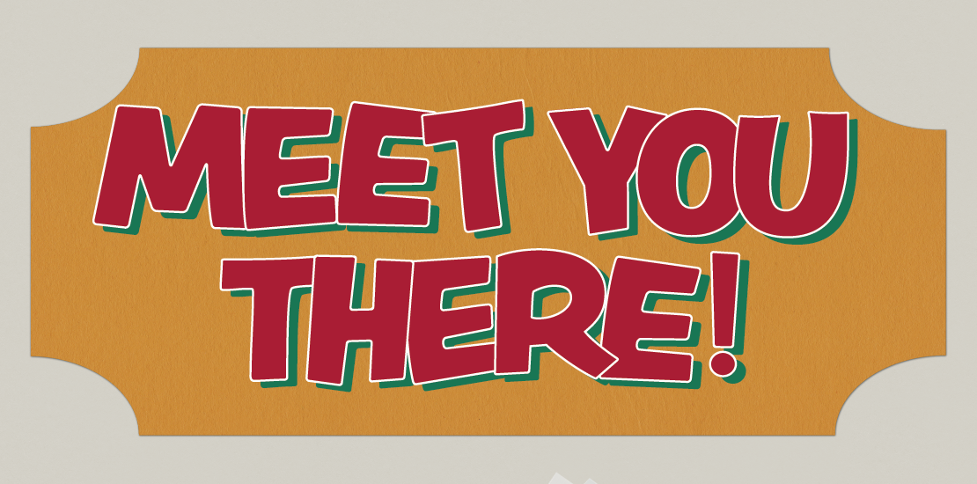

Slide 22
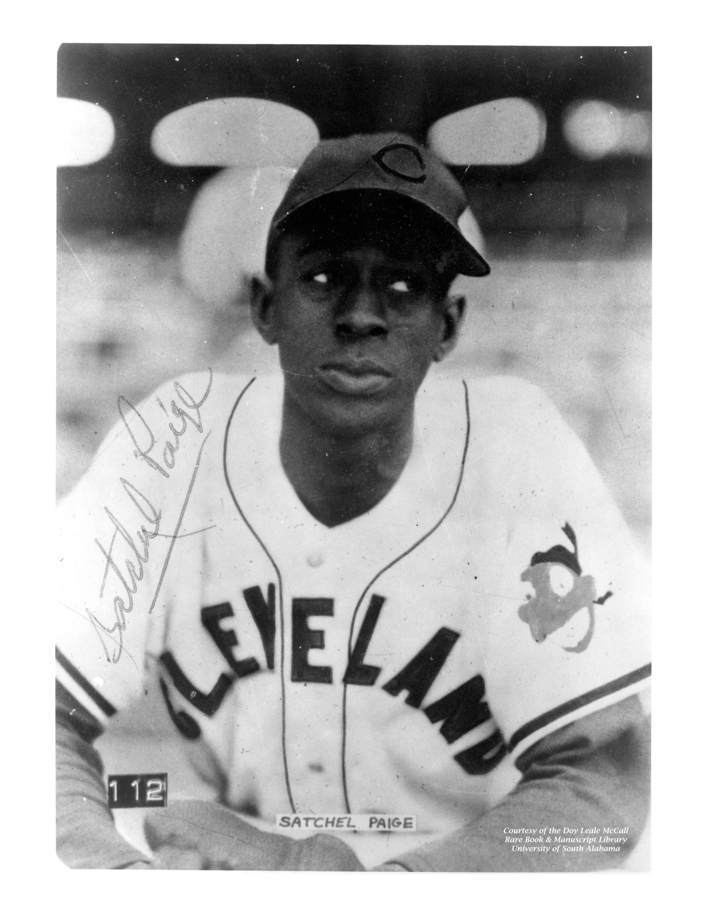
Meet: Satchel Paige
Satchel Paige was one of many baseball players who grew up Down the Bay. Satchel Paige is one of the best pitchers in history, though he wasn’t able to play in the major leagues for many years due to segregation. In 1965, when he was 59, he became the oldest player to pitch in a major league game.
Marshall Wormley, The Doy Leale McCall Rare Book and Manuscript Library, University of South Alabama

Slide 23
Violetta Simpson
“We’d all get together and go skating on Texas Hill... So, you’d go up that and you’d go skating. And I mean, it would be kids from all over; the whole Down the Bay. Maybe 200 kids up there trying to skate down the hill, on Texas Hill.”

Slide 24
What are some of your favorite spots to meet your friends? What do you like to do there?

Slide 25
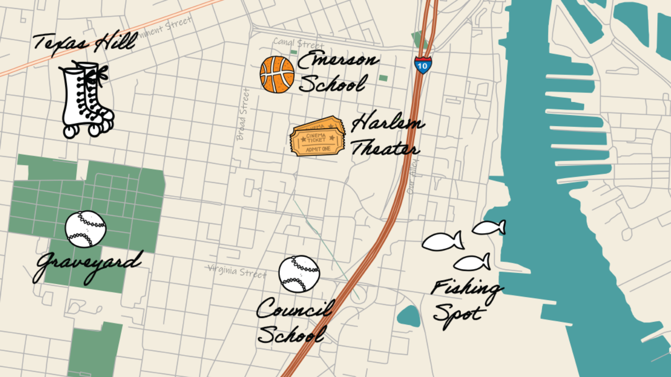
Map Your Neighborhood

Slide 26
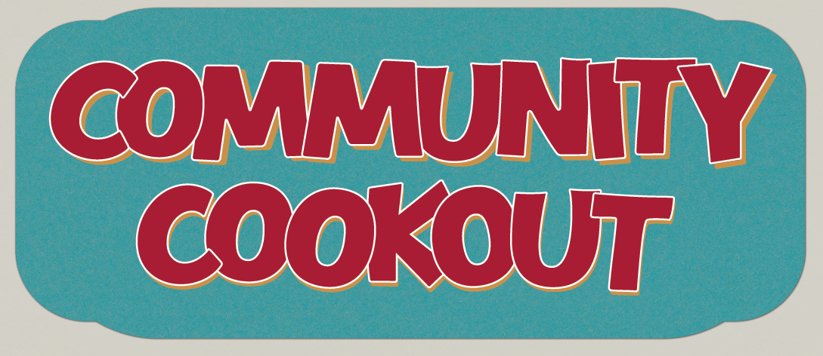

Slide 27
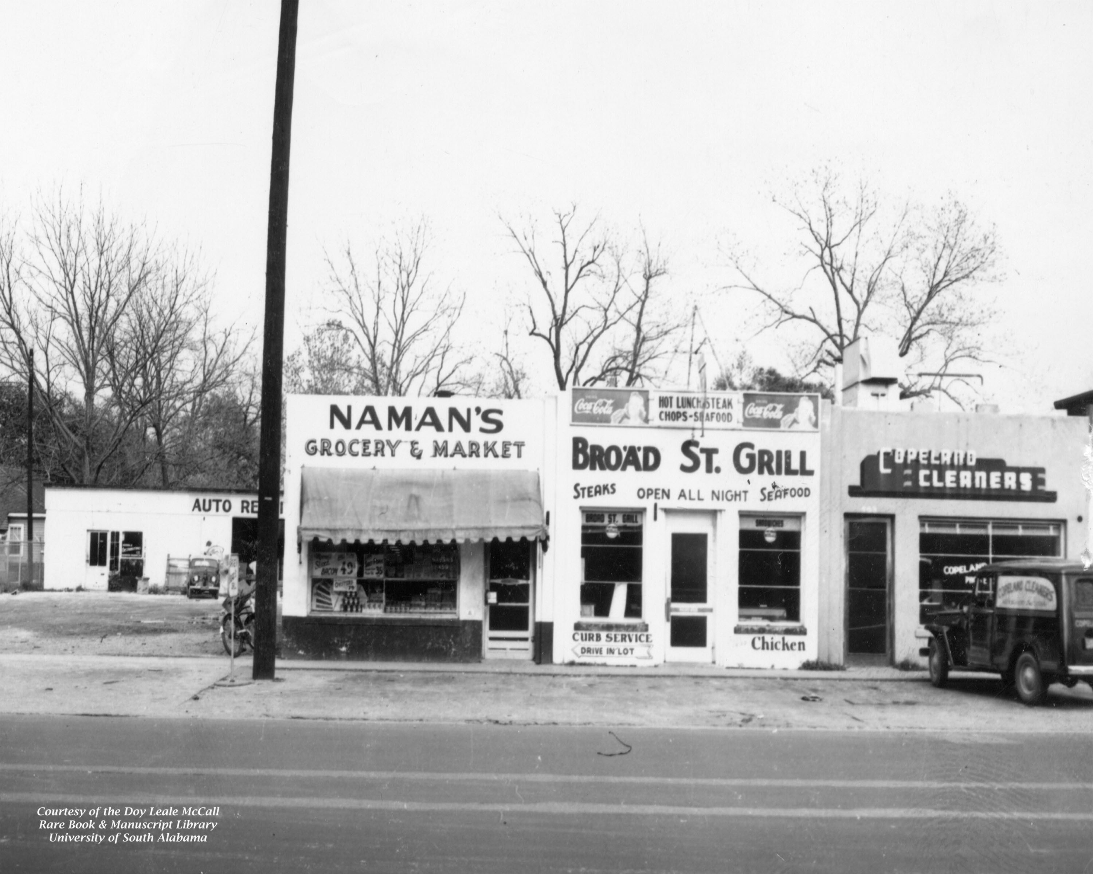
Visit: Naman’s Grocery
Naman’s was one of many grocery stores Down the Bay; in the past, there were many small corner grocery stores instead of the supermarkets we had today. The grocery store owners supported people in the community and knew their customer’s well. Many people have fond memories of shopping at Naman’s, which is still around today.
Julius E. Marx Collection, The Doy Leale McCall Rare Book and Manuscript Library, University of South Alabama

Slide 28
Jamie Hobbs
“Everybody would cook and people would go from house to house, and families came home; it was a homecoming. And like I say, you go to the house: “Come on, have something to eat.” You offered people—if you saw them and they looked hungry, you offered them food.”

Slide 29
Sydney Raine
“Right. And what they were experiencing at the store. And I remember specifically at that particular store, if you didn't have any money, you didn't have to worry about paying for the groceries; they would just write down on a piece of paper that you got this and got that, and you owed this. And when you got the money, you would take it back to the store and pay for whatever goods you got from the store, at that particular time.”
“There was a credit system. Not only a credit system, but an honor system. Because your word was your bond. And they knew it: once they wrote it down, they knew you would eventually come back and pay it.”

Slide 30
What are some of your favorite recipes?
Does your family eat any special foods?

Slide 31
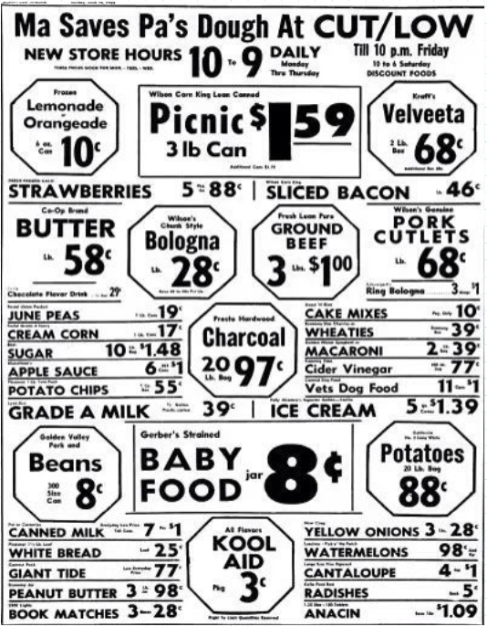
“Put it on my books”
Directions: Use the price list to calculate the total cost of the items from each list. Determine if Mom and Grandma can buy the groceries on their line of credit.

Slide 32


Slide 33
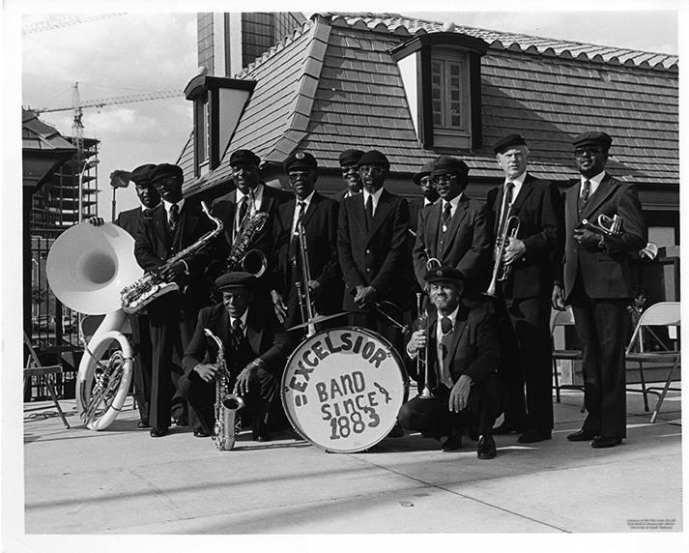
Meet: The Excelsior Band
The Excelsior Brass Band was founded in 1883 by members of the Creole Fire Company No. 1, many of whom lived Down the Bay. The Excelsior Band remains an important part of Mobile culture over 140 years later. Though Down the Bay has changed, the legacy remains through traditions like the Excelsior Band.
Michael Thomason, The Doy Leale McCall Rare Book and Manuscript Library, University of South Alabama

Slide 34
Floyd Eric Draine
“[B]ack then everything was simple; life was simple. Like I say, we just got boxes from the egg company that was right here on Conception Street, and everybody just slid down the bridge. Didn’t take much; just get you a piece of cardboard and come enjoy the fun, you know?”

Slide 35
If you had to leave your neighborhood, what would you miss the most about it?

