Slide 1


Think Like an Archaeologist

Slide 2
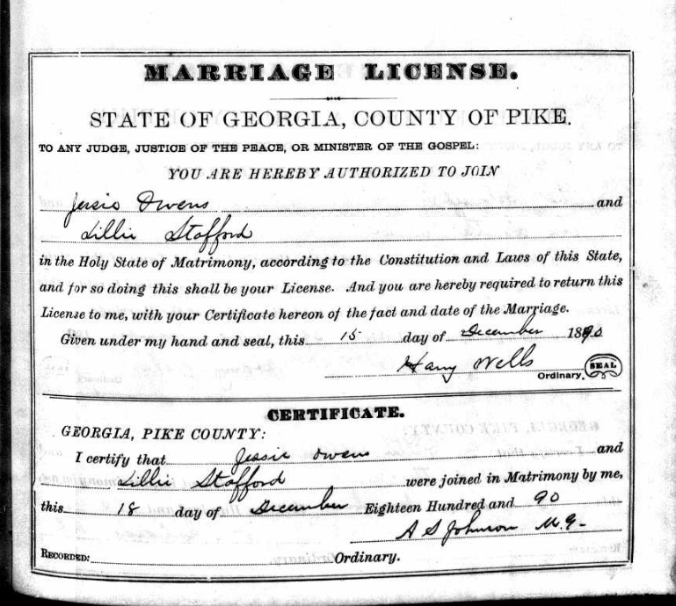
1890 Marriage License

Slide 3

1900 Census

Slide 4
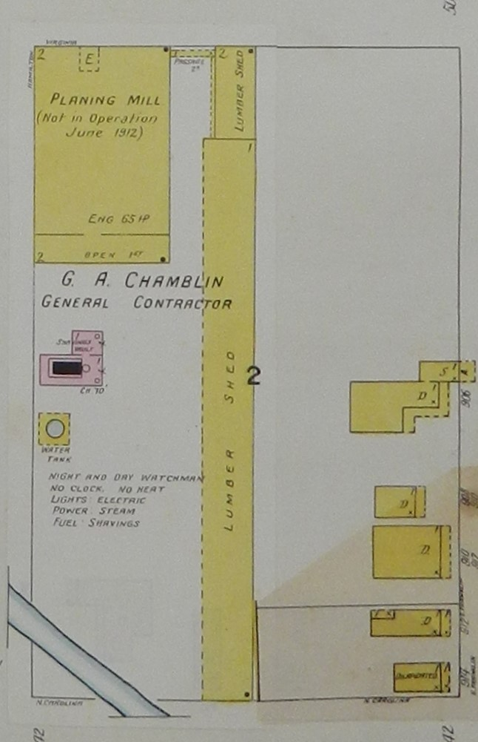
1915 Sanborn Fire Insurance Map

Slide 5
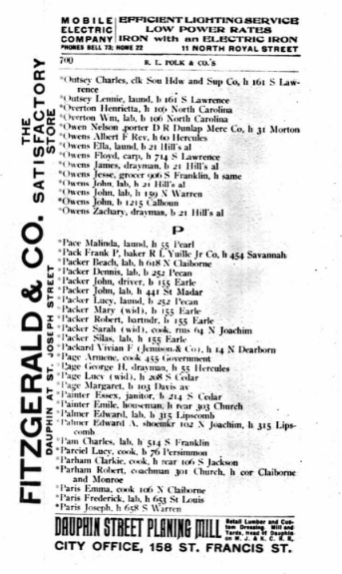
1907
Mobile City Directory

Slide 6
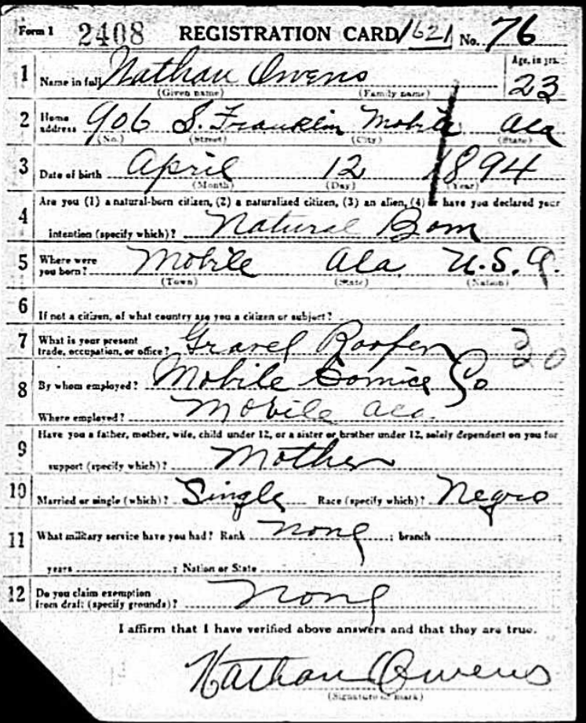
1918
World War I Draft Card

Slide 7
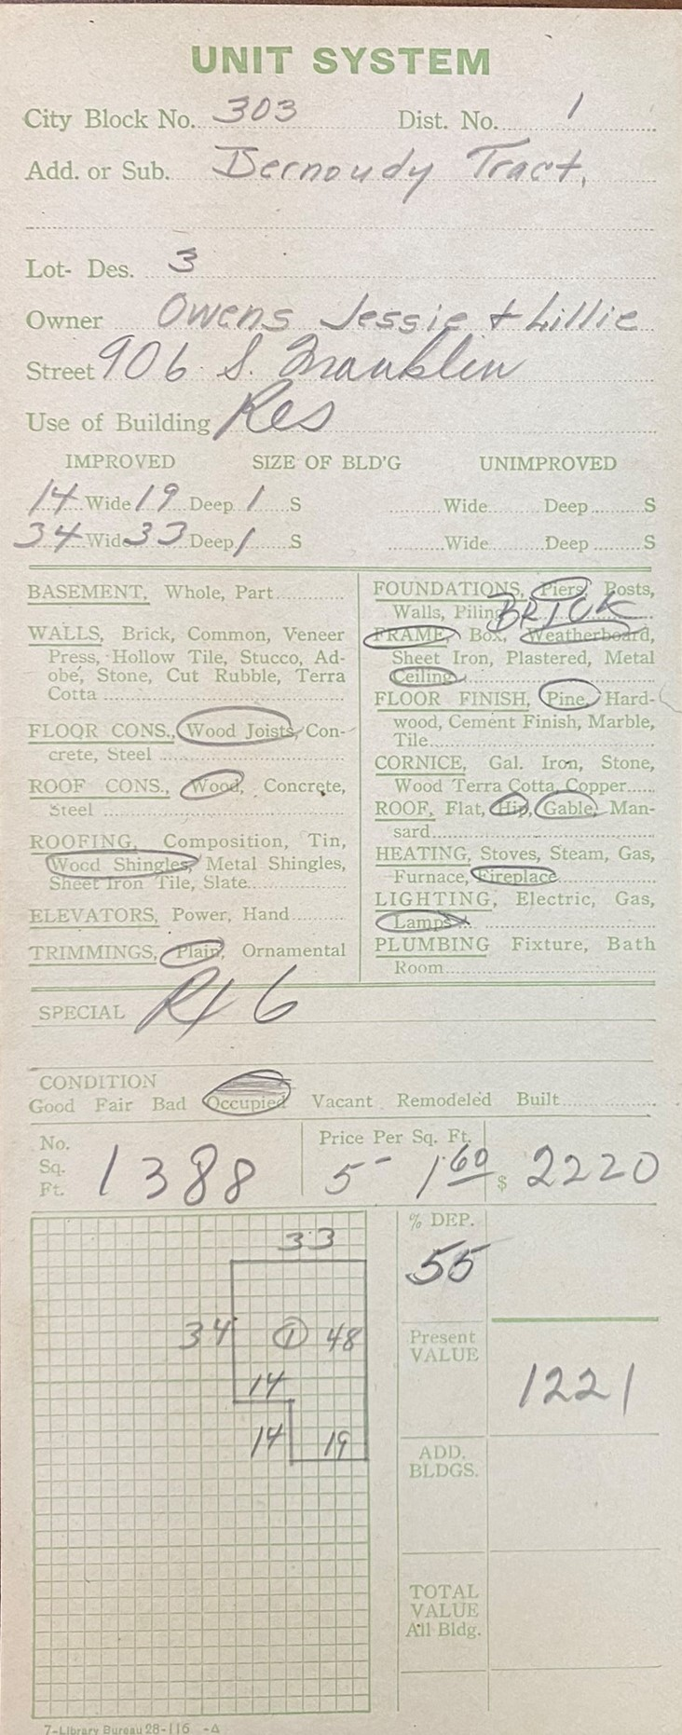
1926 Building Record

Slide 8

1930 Census

Slide 9
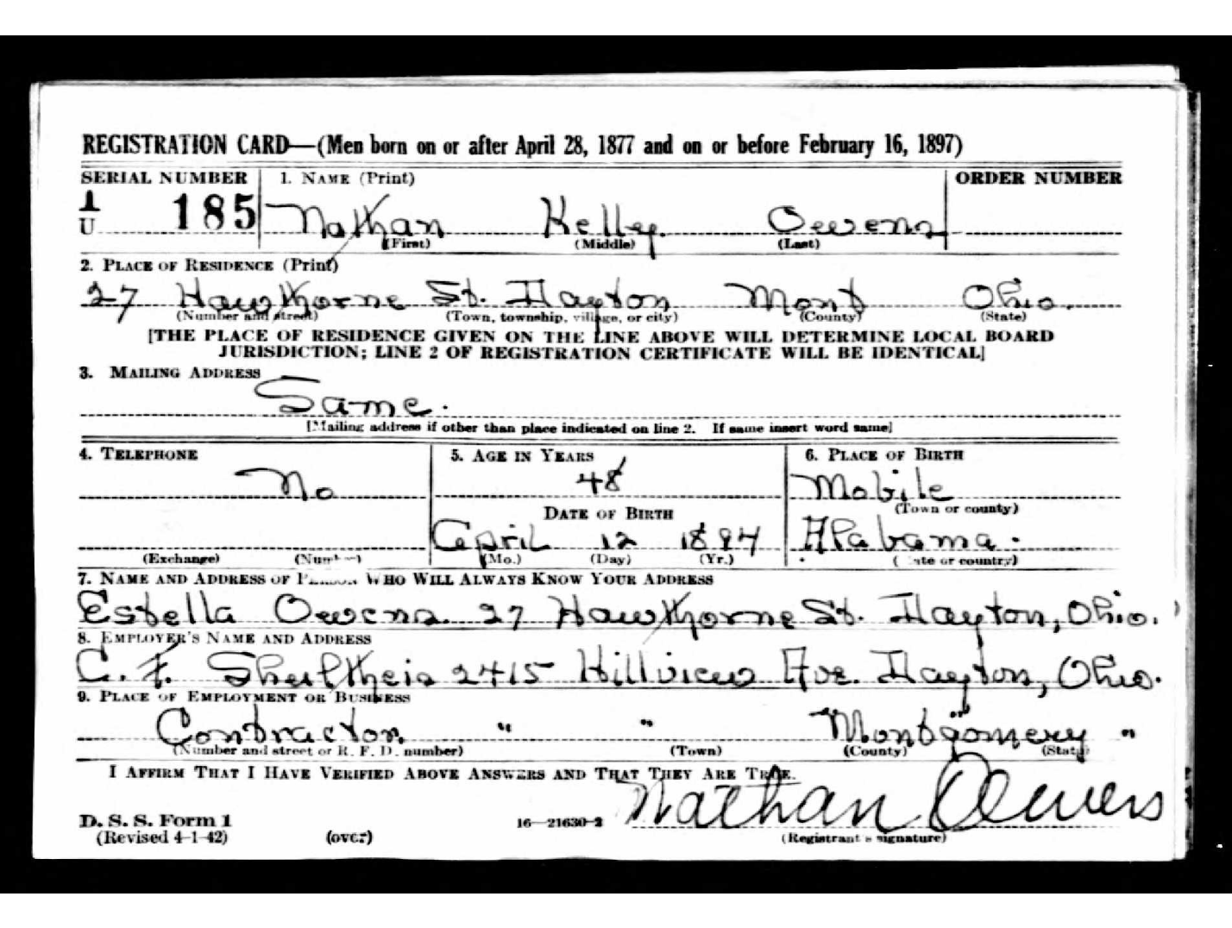
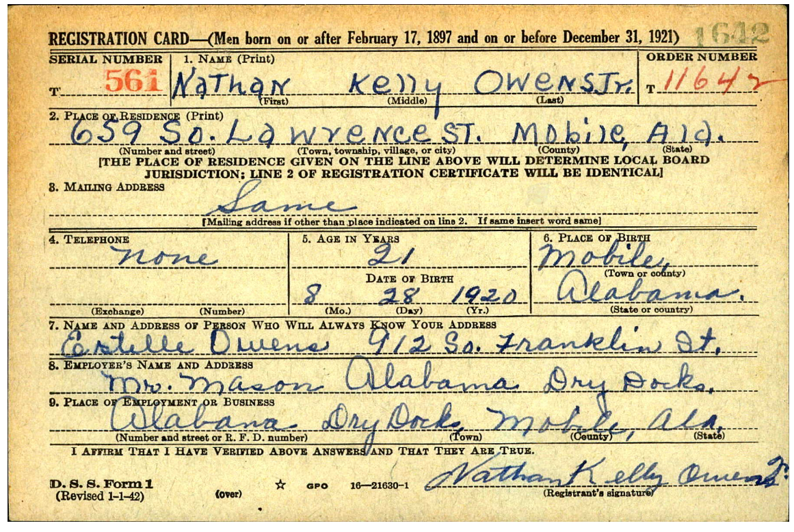
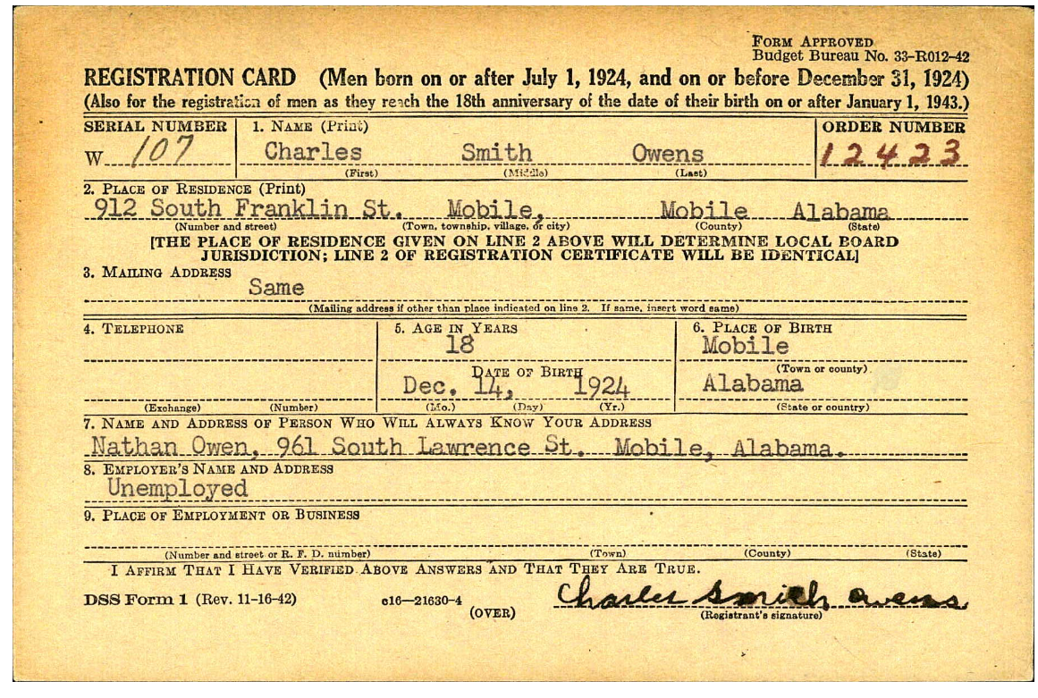
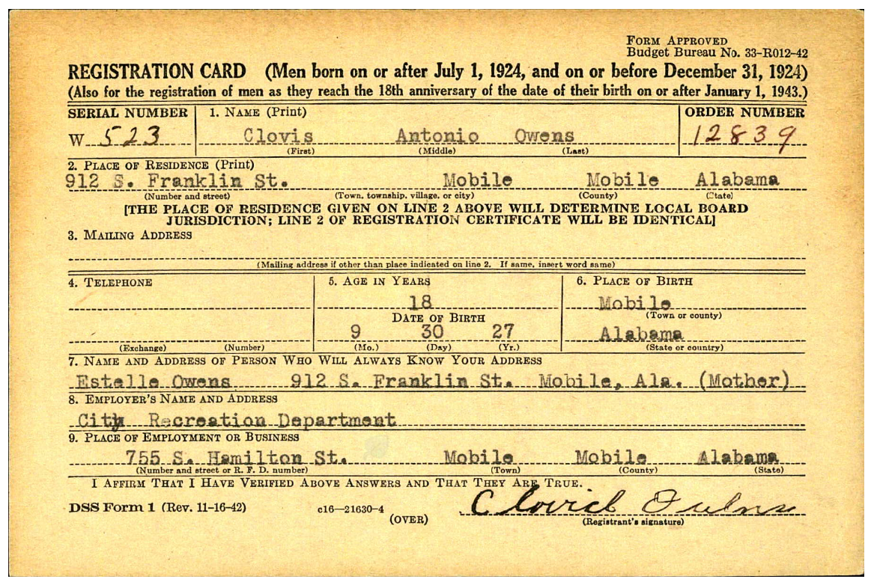
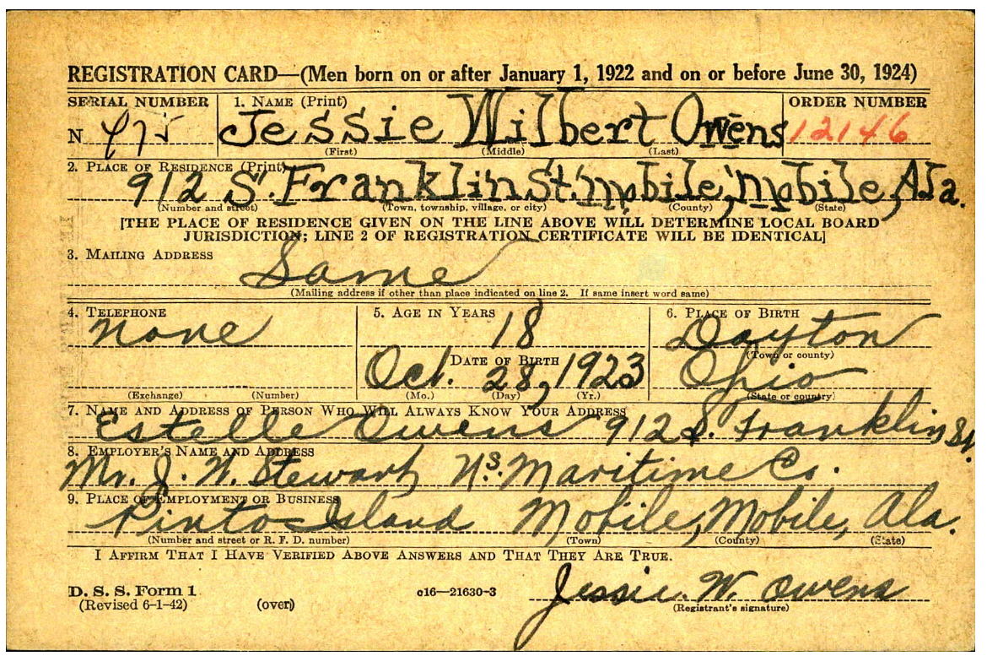
1942 WWII Draft Cards

Slide 10
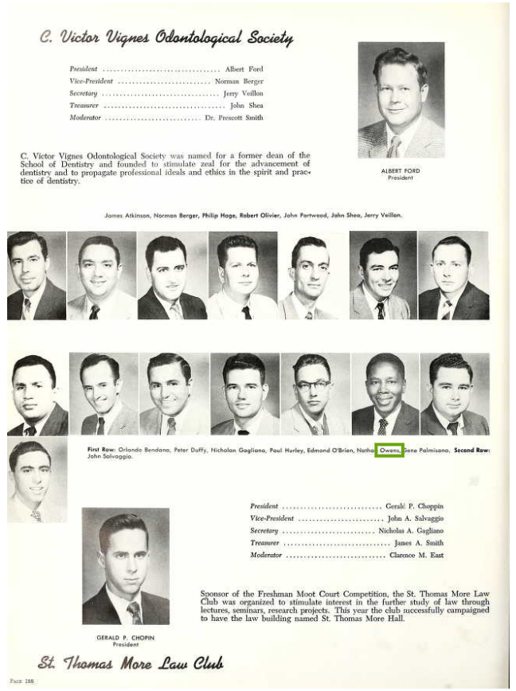
1957
Loyola University Yearbook

Slide 11

1958 Louisiana Weekly Article

Slide 12
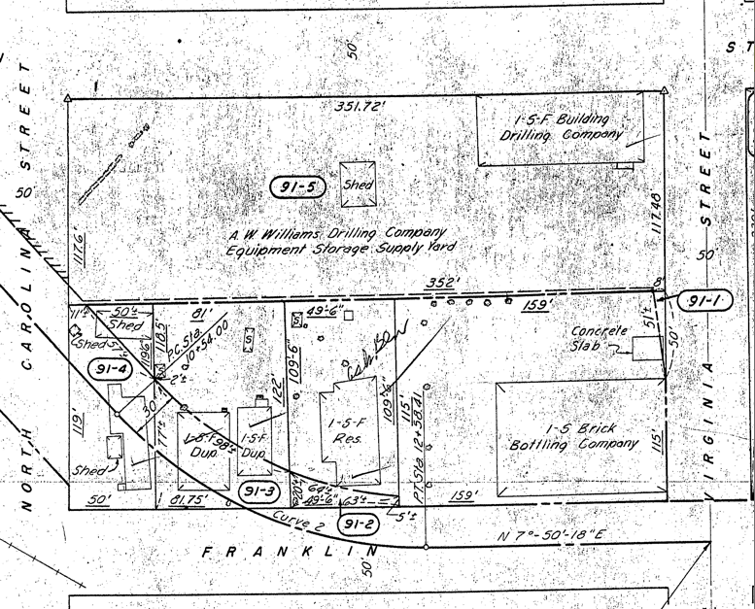
1961 Department of Transportation Map

Slide 13
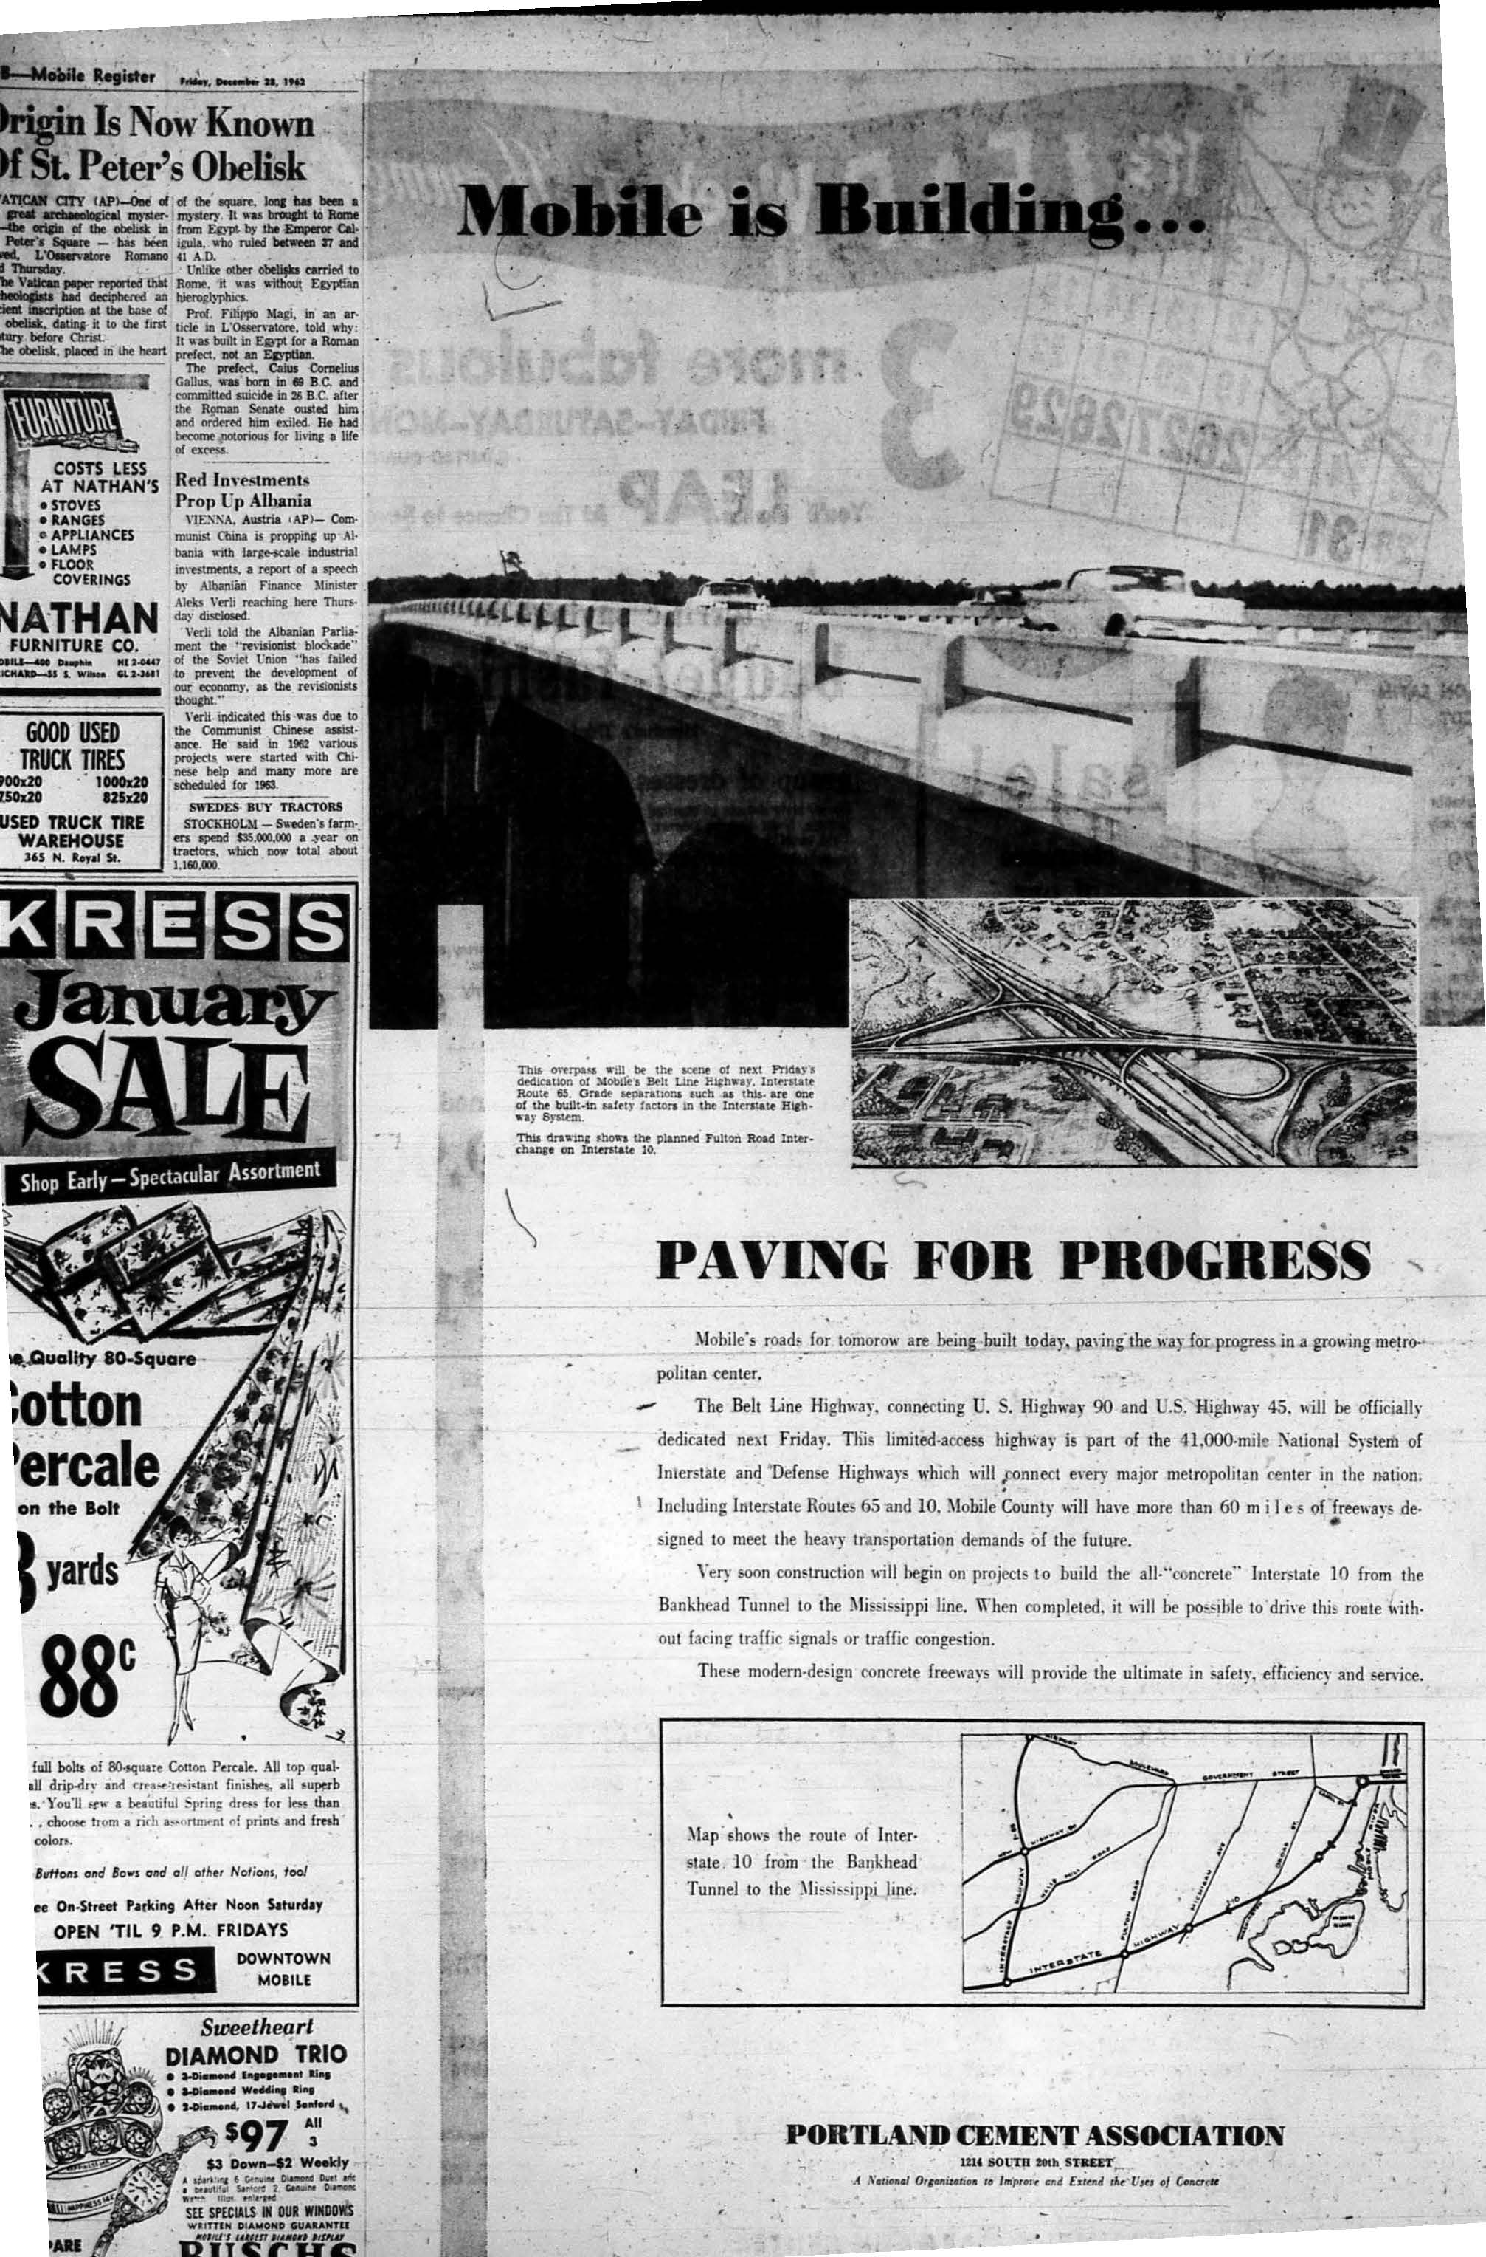
1962
Mobile Register Advertisement

